Slide 1


Event Management System

Slide 2
Abstract
The Event Management System is a web-based platform designed for college students and staff to organize, manage, and participate in campus events.
The system provides an intuitive interface where staff can create and manage events, and students can discover, register, and view event details.
Built using React (frontend), Spring Boot (backend), and MongoDB (database), it ensures scalability, efficiency, and ease of access for all users.

Slide 3
Existing System & Proposed System
Existing System
Proposed System
Manual event registration through Google forms or paper-based methods.
Difficult to track attendees and event capacities.
Event information spread across multiple channels (emails, WhatsApp, notice boards).
Lack of centralized data storage or event analytics.
A centralized web platform for all departmental and college events.
Staff login for event creation, editing, and managing registrations.
Student login for browsing and registering for events.
Real-time updates and notifications on successful registrations or event creation.
Data stored securely in MongoDB via a Spring Boot REST API.

Slide 4
Advantanges & Disadvantanges
Advantanges
Disadvantages
Efficient event organization and management.
Real-time data synchronization between frontend and backend.
Easy tracking of registrations and event capacities.
Secure user login and role-based access (Staff vs Student).
Simple, responsive, and modern UI built with React.
Requires an internet connection to function.
Limited offline access.
Dependent on backend server uptime.

Slide 5
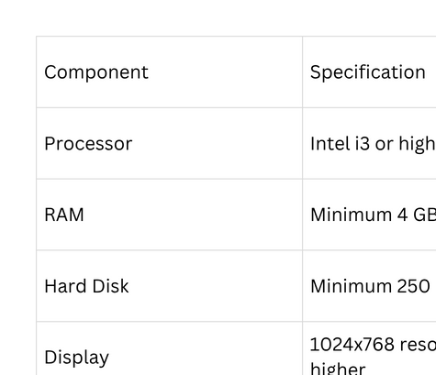
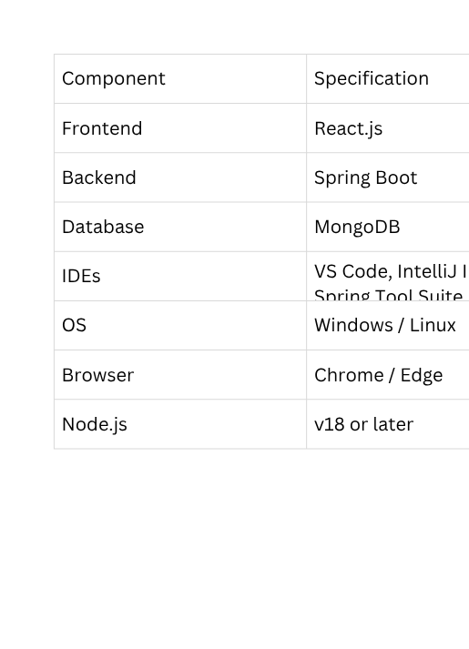
Requirement
Hardware Requirements
Software Requirements

Slide 6
Modules
Login & Authentication Module
Handles login for staff and students using email credentials.
Event Creation Module (Staff)
Staff can create, edit, and delete events.
Event Discovery Module (Students)
Displays all upcoming and active events.
Event Registration Module
Students can register/unregister for events.
Notification Module
Displays success messages (e.g., “Login Successful”, “Registered Successfully”).
Database Module
Stores event and user data using MongoDB.

Slide 7
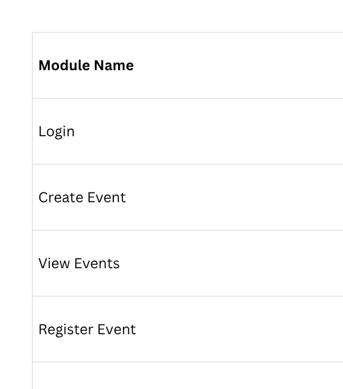
Module Description

Slide 8
Conclusion
Sample output
(uploaded in github(outputs))
The Event Management System simplifies the entire event organization process for educational institutions.
It bridges the gap between students and staff through a unified digital platform.
Future enhancements can include:
Email notifications for registered events.
Event analytics and attendance reports.
Admin dashboard for overall event insights.
Login Page (Staff/Student)
Dashboard (List of Events)
Create Event Form (Staff)
Registration Page (Student)
MongoDB data view (show saved event & user details)
Notification popup examples (“Login Successful”, “Registered Successfully”)

Slide 9


Thank you!

